Slide 1
One Shot Instructions
© 2015 John Sefcovic

Slide 2
One Shot
A One Shot are instructions that makes the rung true for one program scan upon a transition of the rung by the input conditions preceding the one shot instruction on the rung.
Use the One Shot instructions to start events triggered by a pushbutton or limit switch that are only to be true (ON) once.
To control the one-shot pulse transition, a Storage Bit is entered. Depending on the instruction a pulsed Output Bit.
There are two types of one shot functions:
              One Shot Rising
              One Shot Falling

Slide 3
One Shot
One Shot Rising
The One Shot Rising will cause on the false-to-true transition of the Input to turn On the Output for one scan.
INPUT
OUTPUT
ONE
SCAN

Slide 4
One Shot
One Shot Falling
The One Shot Falling will cause on the true-to-false transition of the Input to turn On the Output for one scan.
INPUT
OUTPUT
ONE
SCAN

Slide 5



One Shot
RSLogix 5000 One Shot instructions are the:
One Shot (ONS) input.
One Shot Rising (OSR) output.
One Shot Falling (OSF) output.

Slide 6

One Shot
The One Shot (ONS) instruction is used as input, om the rising transition, to make the rung’s output true for one scan.
The one shot rung output’s pulsed status is used as a condition on additional rungs for other control functions.

Slide 7
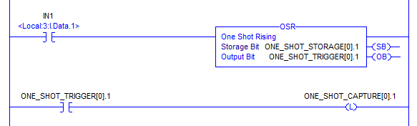
One Shot
The One Shot Rising (OSR) is an output instruction. A Storage Bit tracks the false-to-true transition of the rung, and the Output Bit is trigger ON for one scan on the transition.
The Output Bit’s pulsed status is used as an input condition on additional rungs for other control functions.

Slide 8
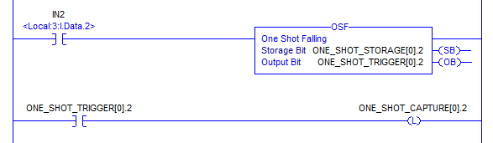
One Shot
The One Shot Falling (OSF) is an output instruction. A Storage Bit tracks the true-to-false transition of the rung, and the Output Bit is trigger ON for one scan on the transition.
The Output Bit’s pulsed status is used as a input condition on additional rungs for other control functions.

Slide 9

One Shot
The One Shot instruction buttons are in the Bit Tab for RSLogix 5000.

